Slide 1
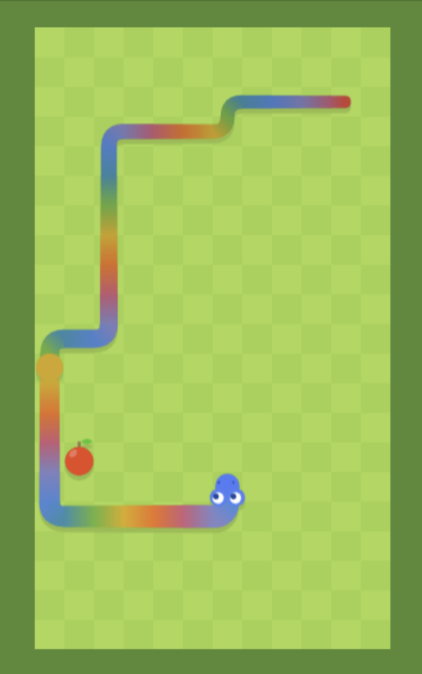
COBRA SNAKE
COMP 123: Core Concepts in Computer Science Macalester College | December 2025
Elma Mostic | Kampe Rushoka | Providence Thusabantu | Jack Dong

Slide 2
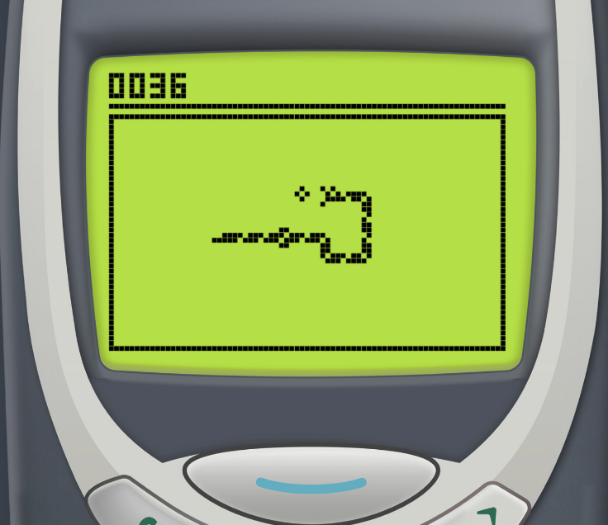
Project Overview
Objective
Key Features
Recreate the classic Snake game with modern features using object-oriented programming principles
Three difficulty levels (Easy/Medium/Hard)
Real-time collision detection
Dynamic obstacle generation
Technology Stack
Score tracking system
Python 3.13
Background music integration
Pygame 2.6.1
Git version control

Slide 3
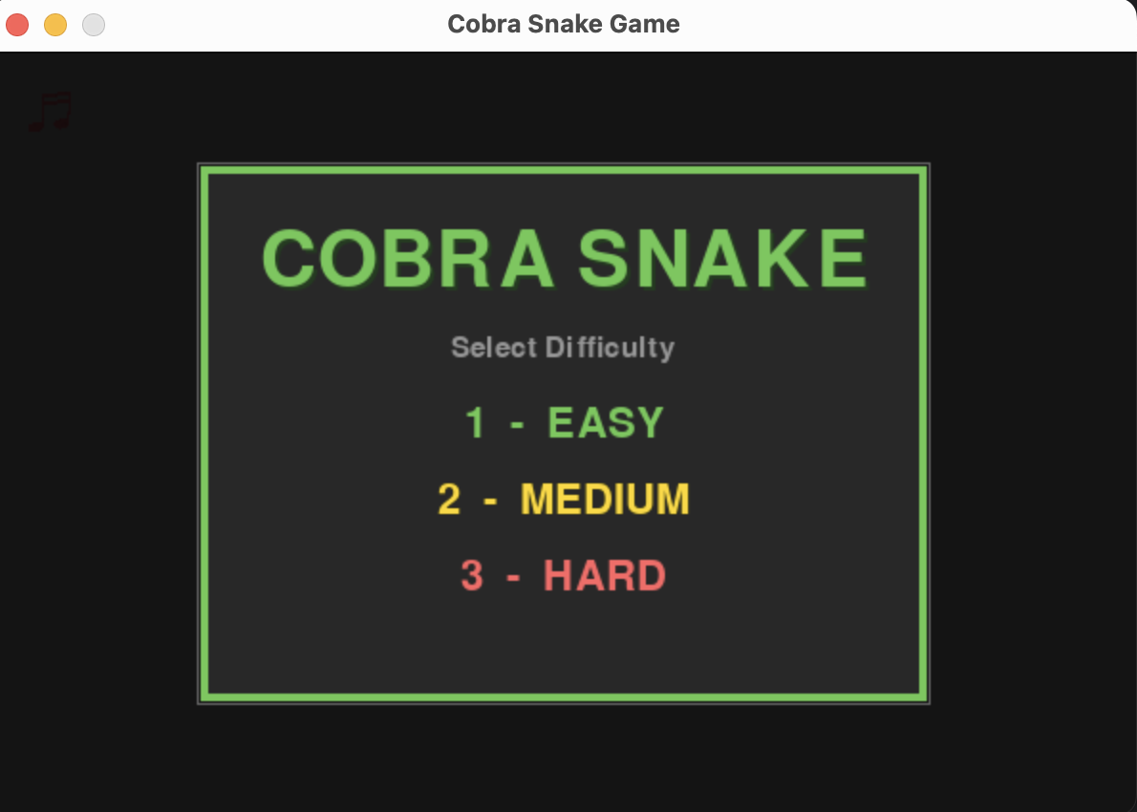
Gameplay Demonstration
Choose Difficulty
Navigate & Grow
Select Easy, Medium, or Hard mode
Use arrow keys to control snake and collect food
Avoid Hazards
Dodge walls, obstacles, and your own tail
Live demonstration: 90 seconds of gameplay showcasing core mechanics

Slide 4

Live Demonstration

Slide 5

Object-Oriented Design
Five core classes encapsulate game functionality with clear separation of concerns
1
2
3
🐍 Snake
🍎 Food
💥 Collision Detector
Movement logic, growth mechanics, and rendering
Position generation and collision validation
Boundary and entity collision checks
4
5
📊 Score
🚧 Obstacles
Point accumulation and display
Dynamic hazard generation with safe spawning
Design Principle: Each class encapsulates a single responsibility. Modular structure enables independent development and testing.

Slide 6
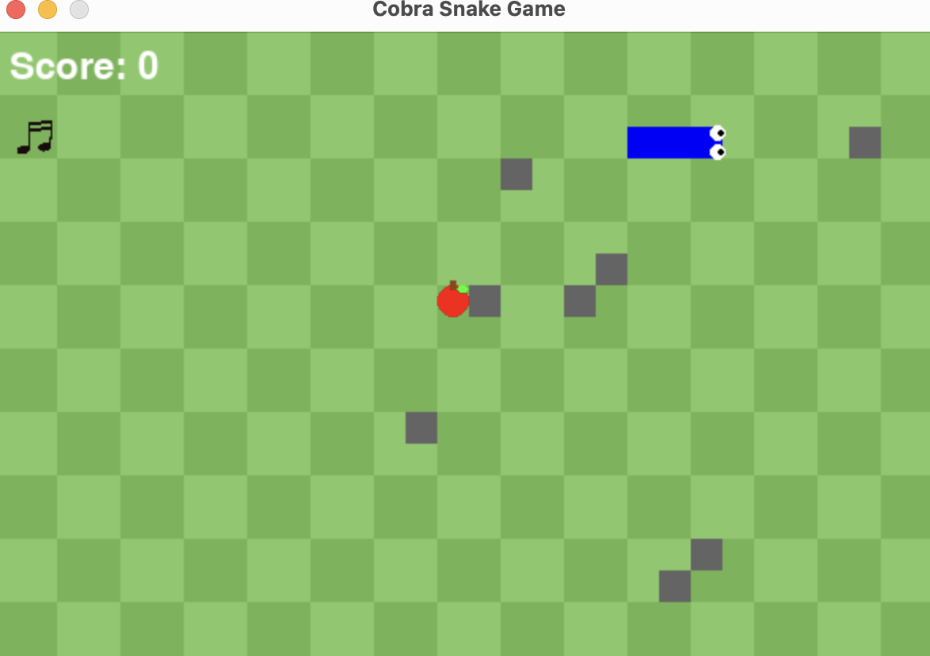
Snake Movement Algorithm
def move(self):
"""Move snake one step."""
head = self.body[0]
# Calculate new head
if self.direction == 'UP':
new = [head[0],
head[1] - self.size]
elif self.direction == 'DOWN':
new = [head[0],
head[1] + self.size]
self.body.insert(0, new)
if not self.growing:
self.body.pop()
else:
self.growing = False
How It Works
Calculate new head position based on direction
Insert new head at front of body list
Remove tail unless snake is growing
List operations enable O(1) growth

Slide 7



Collision Detection System
Wall Collision
Validate boundary constraints—check if head exceeds screen dimensions
Food Collision
Exact coordinate matching between snake head and food position
Self Collision
Head-body intersection test to detect if snake hits itself
def check_wall_collision(self, snake_head):
x, y = snake_head
return (x < 0 or x >= self.screen_width or
y < 0 or y >= self.screen_height)
Three validation checks executed every frame ensure accurate game state

Slide 8
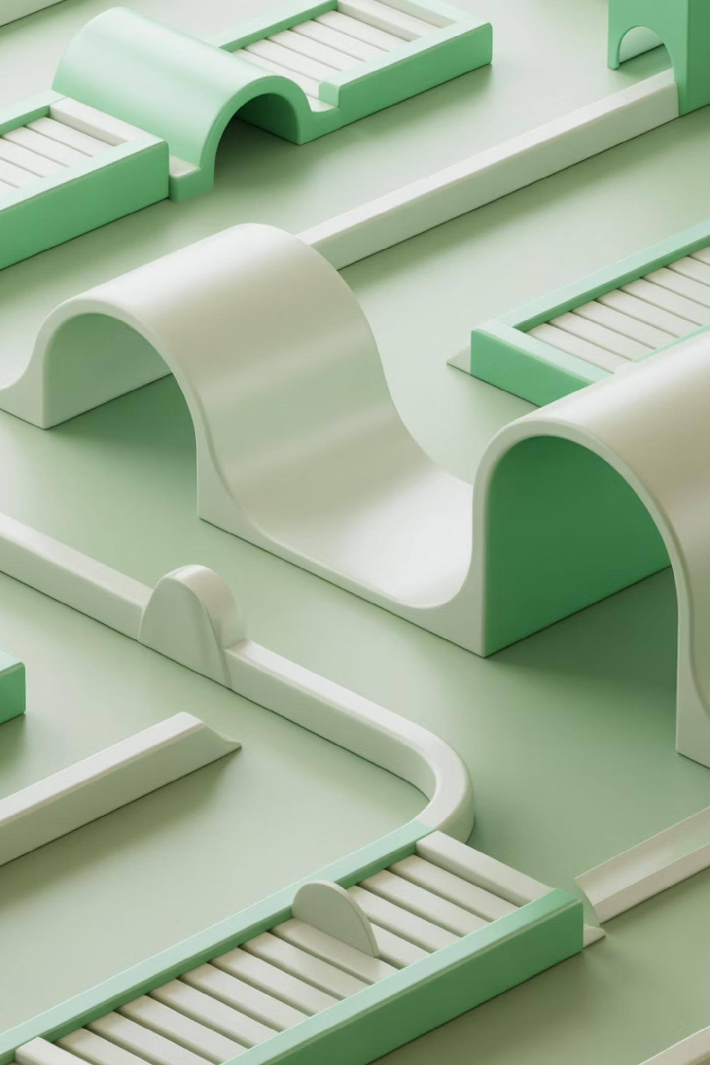

Obstacle Spawning
1
2
Random Position
Distance Check (improvement & debugging)
Generate X,Y coordinates on 20-pixel grid
Ensure 3-block minimum distance from all snake segments
3
Validate & Place
Confirm no overlap with snake or food, then add obstacle
SAFE_DISTANCE = 3 blocks prevents unfair spawns that trap the player

Slide 9
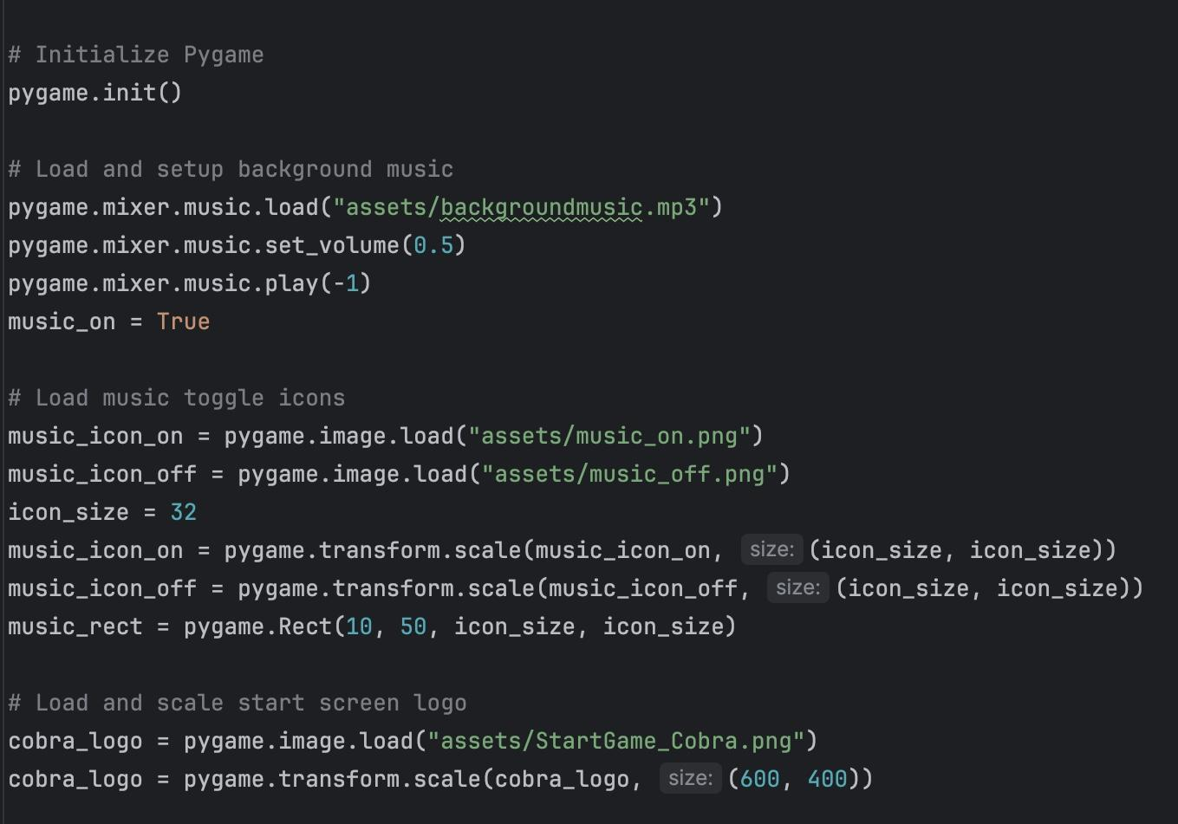
Aesthetic Features We Added to Enhance the Game
Snake features (Eyes)
Added two small circles inside the snake’s head.
Implemented using simple coordinates and the drawing function already used for the snake blocks.
The eyes update automatically as the snake moves.
Custom Apple Design
Changed the apple from a plain red block to a circular fruit shape, with stem.
Used a different drawing function and a distinct RGB color to make it stand out.
Background Music
Loaded a sound file using the game’s audio library (e.g., pygame.mixer)
Used mixer.music.load() and mixer.music.play(-1) to loop music continuously..
Background Design
Modified the game window background to get the predefined green background of the original game
After user feedback we modified the welcome page screen background to be simple and professional
Adjusted block size and movement speed for smoother gameplay.
Updated score text styling (font, color, size) for easy readability.
Additional Enhancements
Adding in background music

Slide 10
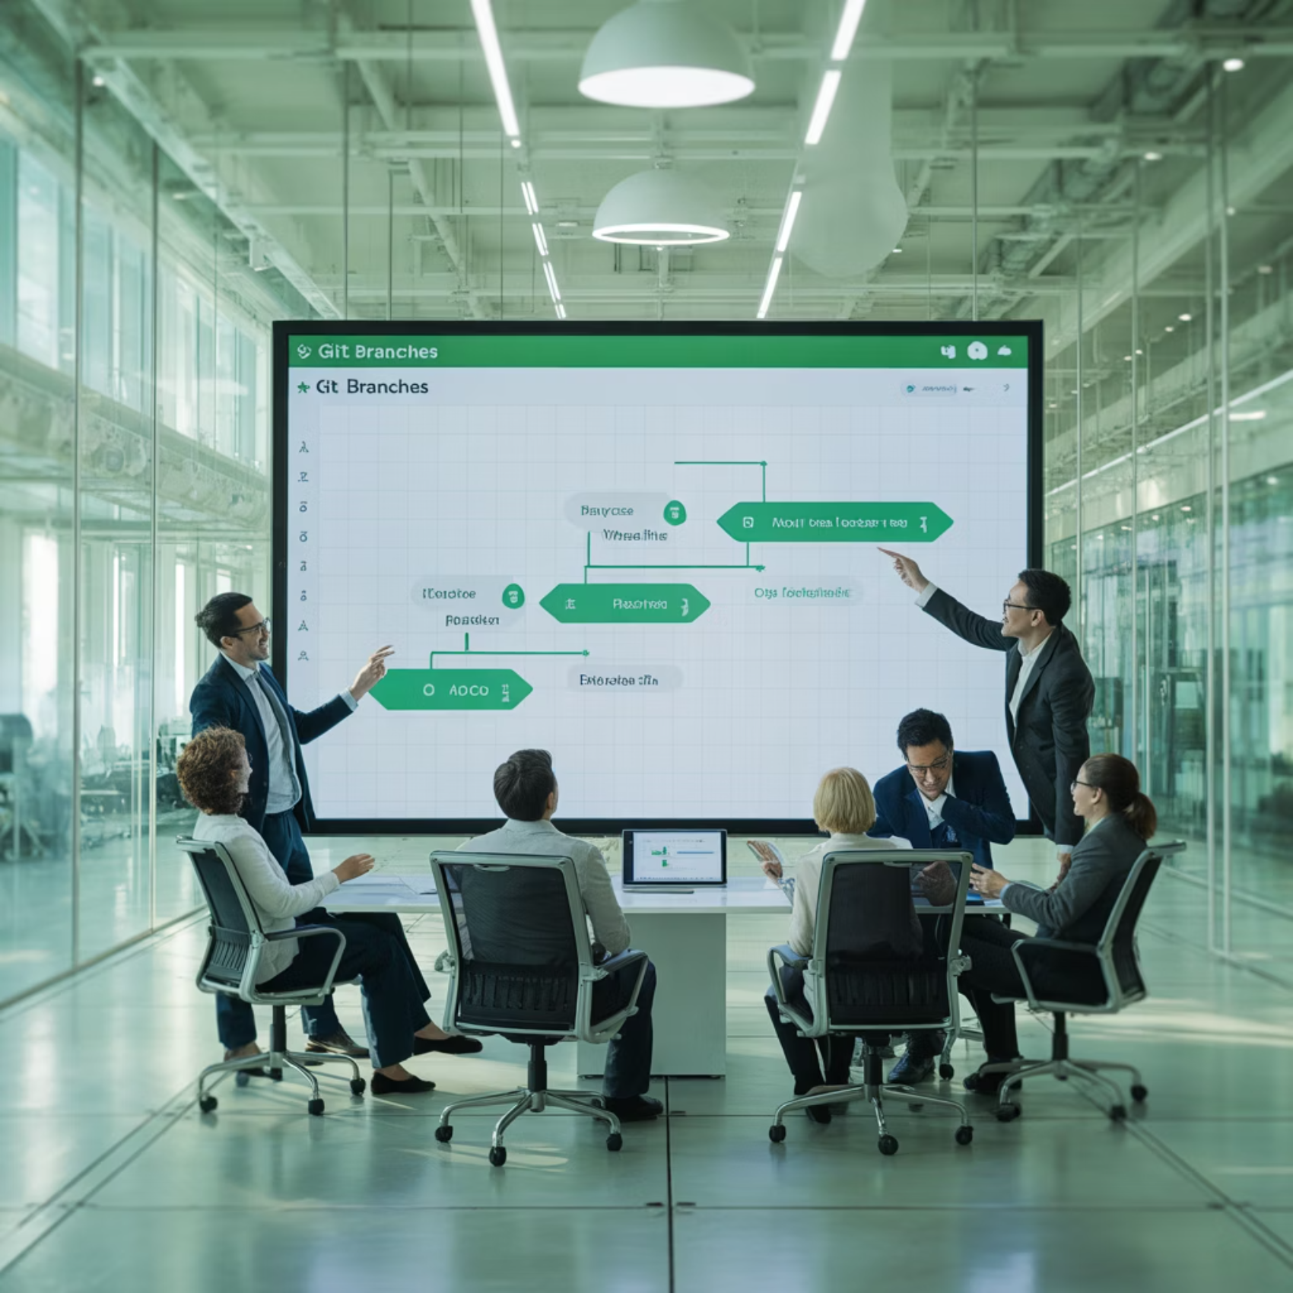
Key Takeaways
Technical Competencies
Object-oriented design patterns
Game loop architecture and frame management
Algorithm implementation (collision detection)
Problem decomposition
Debugging complex state-dependent systems
Code documentation and maintainability
Iterative development approach
Team Coordination skills
Result: Minimal merge conflicts and smooth collaboration throughout the project
Notes:
"Working on the Snake game gave us hands-on experience in both technical skills and teamwork. we started by practiced problem decomposition, starting with a prototype and ending with a fully functioning game, breaking the project into manageable pieces. Later We applied object-oriented design patterns, structuring the game with classes and methods to keep the code organized and reusable. Using an iterative development approach, we refined the game step by step. Building on that, we developed the game loop infrastructure and frame management, which allowed the game to continuously update and render frames, ensuring smooth snake movement, consistent timing, and responsive gameplay
We also learnt new algorithms like collision detection, enabling the game to accurately recognize when the snake hits walls or itself. As well as learned new methods such as pygame, to add new features like music.
Lastly, we really honed our debugging skills, learning to systematically identify, isolate, and fix issues in the code. This involved reading and interpreting error messages, tracing logic step by step, and testing different parts of the game independently.
as well as maintaining documentation and code readability throughout the entire code , for easy team collaboration. Talking about team collaboration, we practiced strong team coordination and teamworking skills by dividing tasks, communicated effectively, and helping one another. Overall, this project deepened our coding skills while highlighting the importance of collaboration and structured problem-solving."

Slide 11
Thank You
Questions & Discussion
Repository: https://github.com/mac-comp123-f25/project-cobra
Elma Mostic | Kampe Rushoka| Providence Thusabantu| Jack Dong

